Slide 1
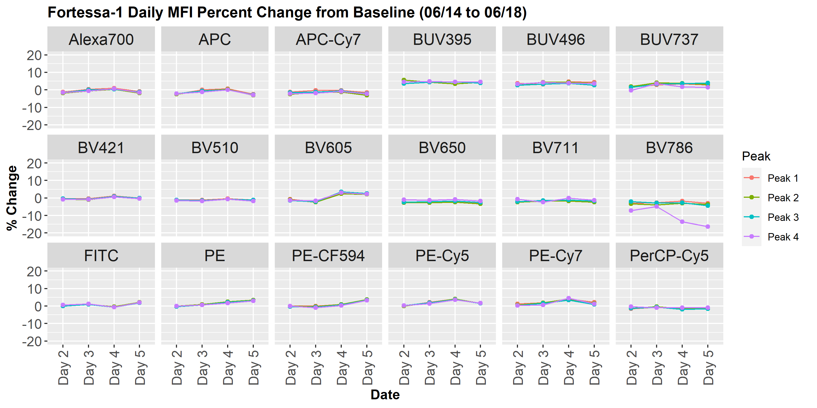
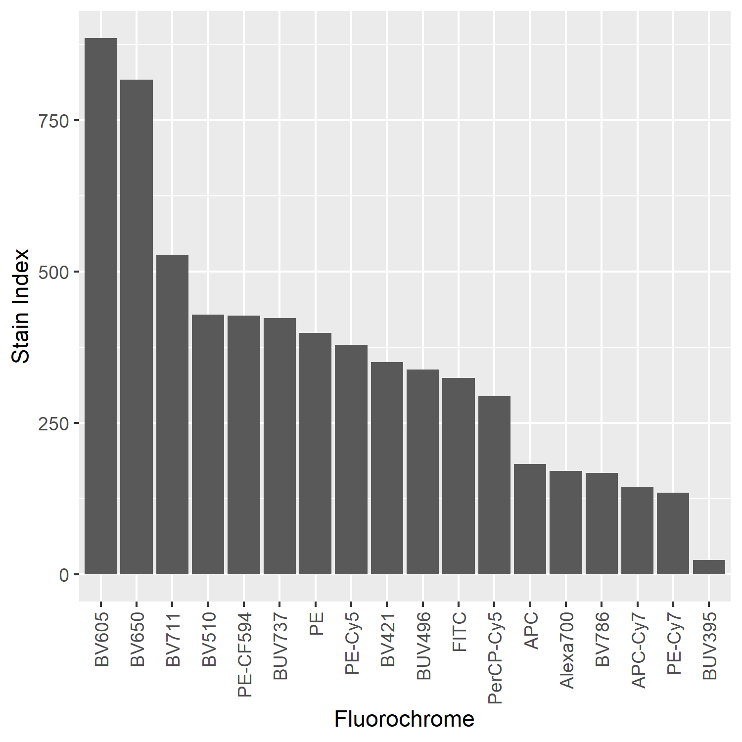
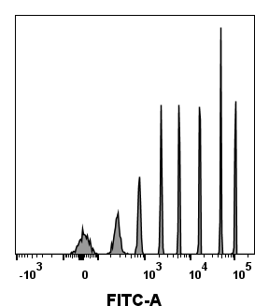
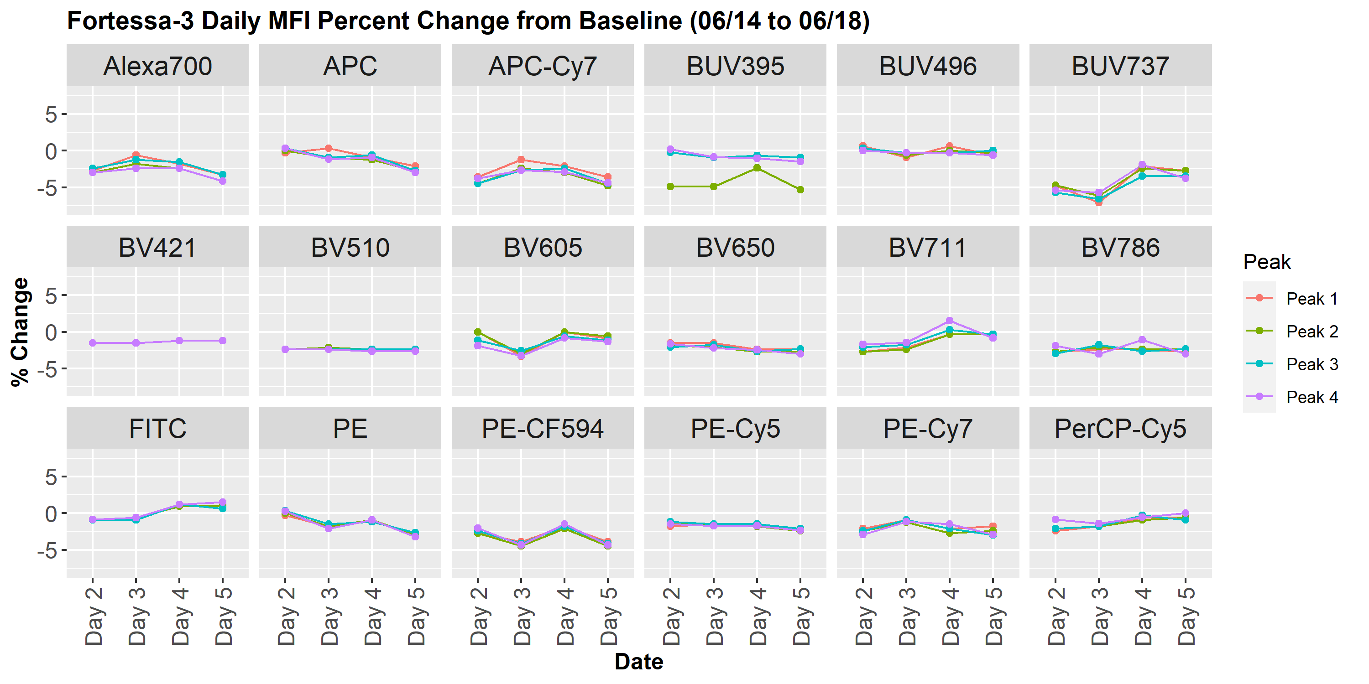
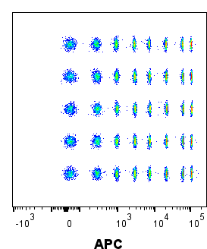
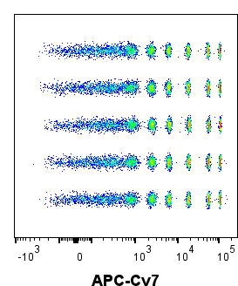
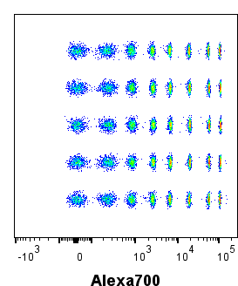
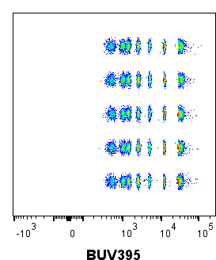
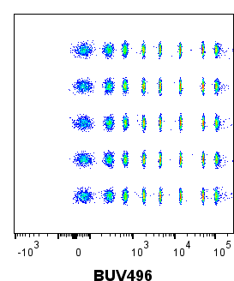
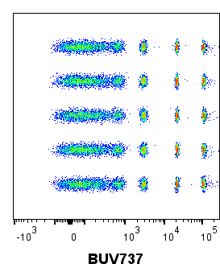
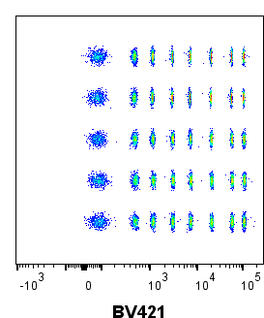
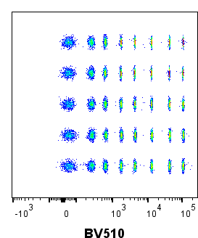
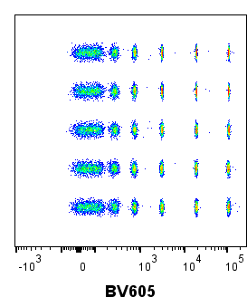
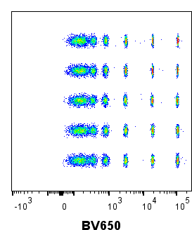
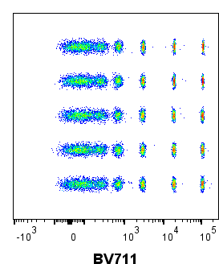
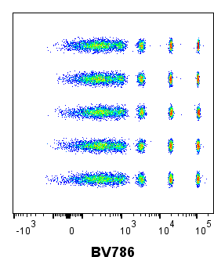
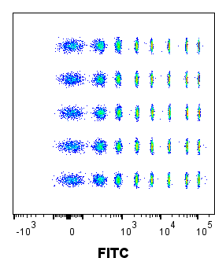
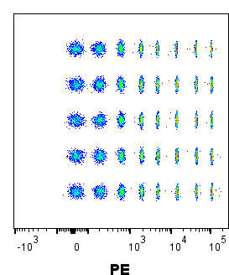
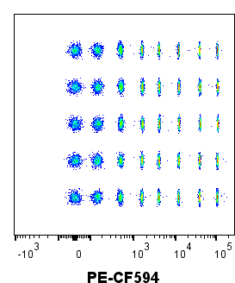
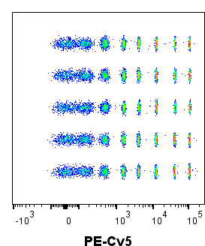
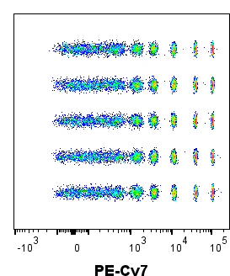
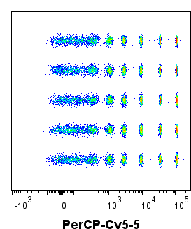
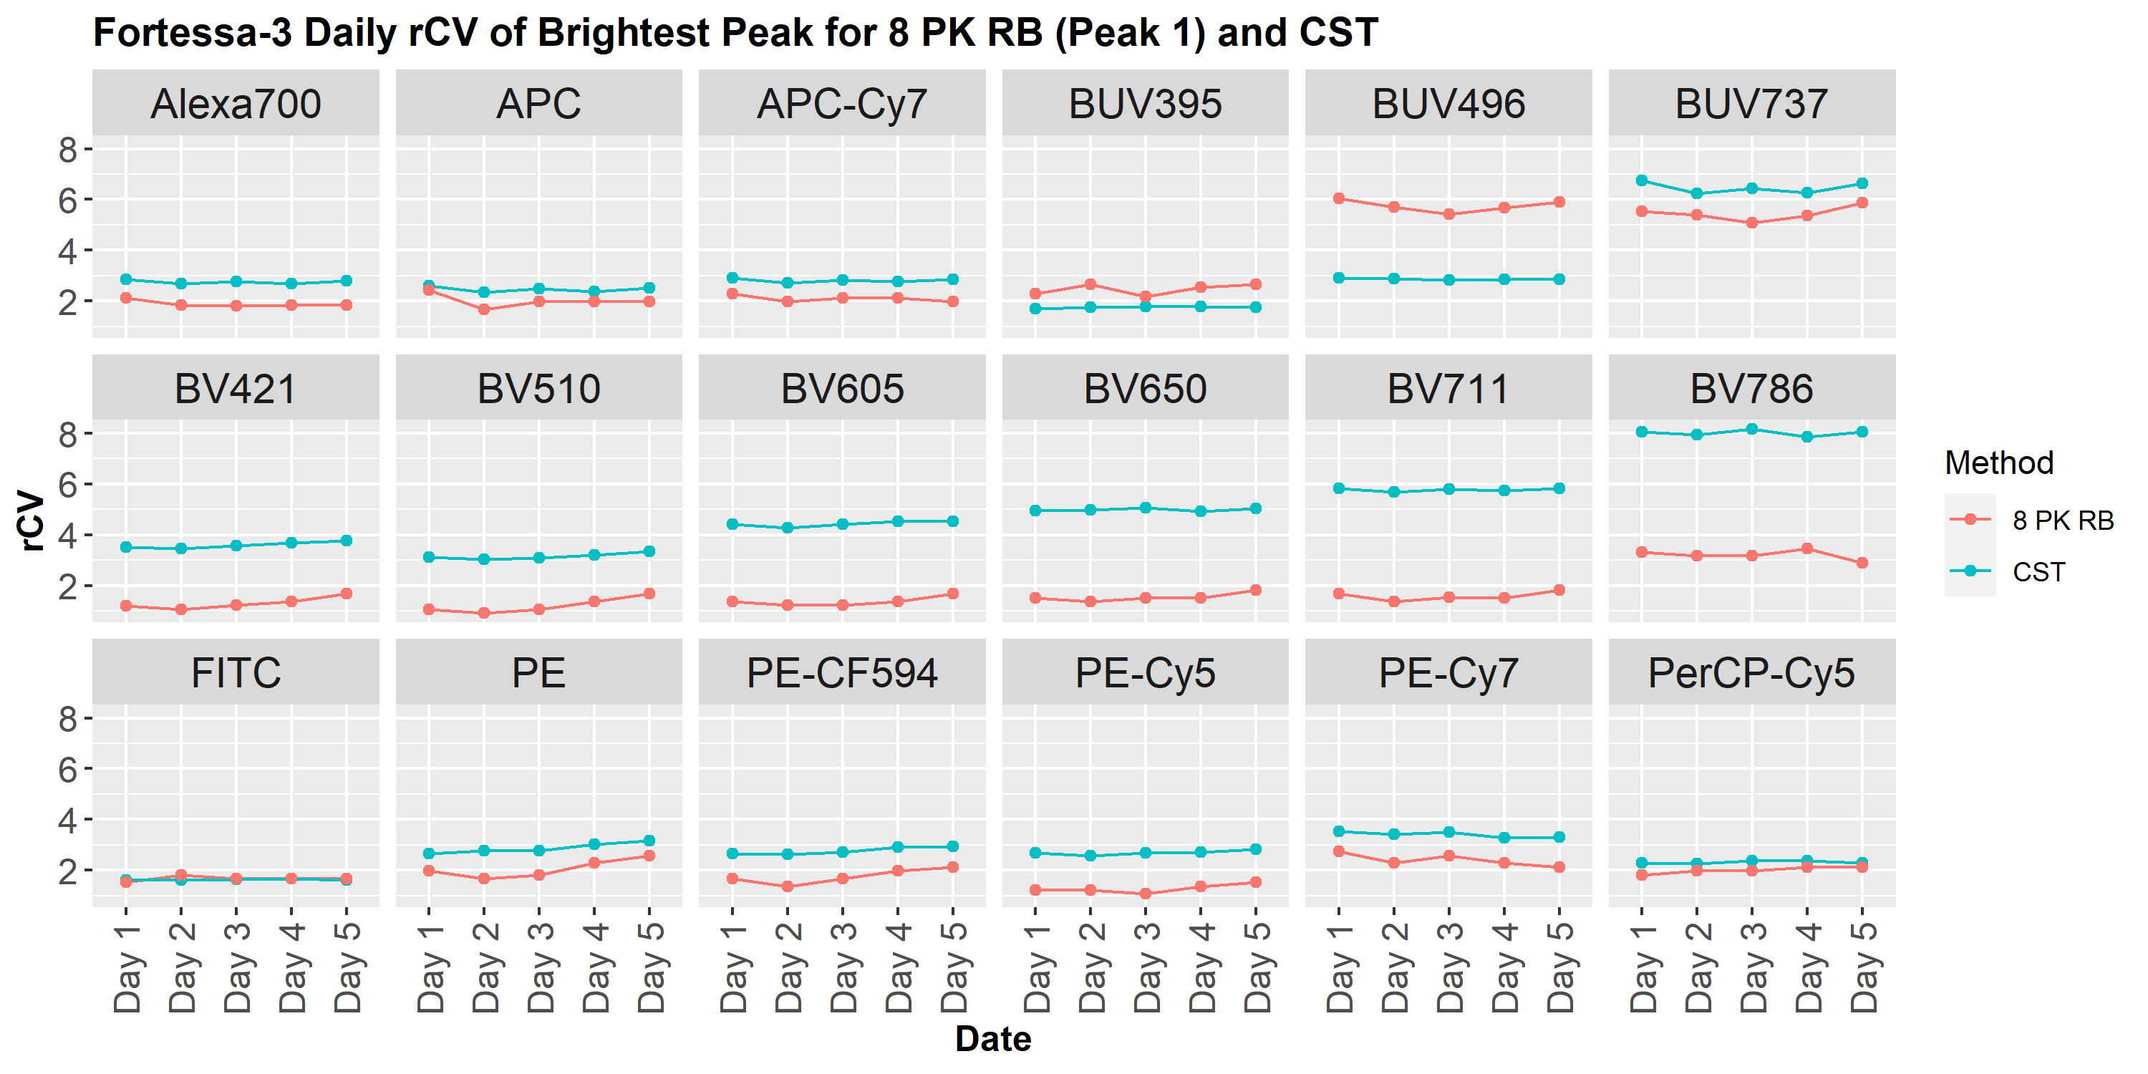
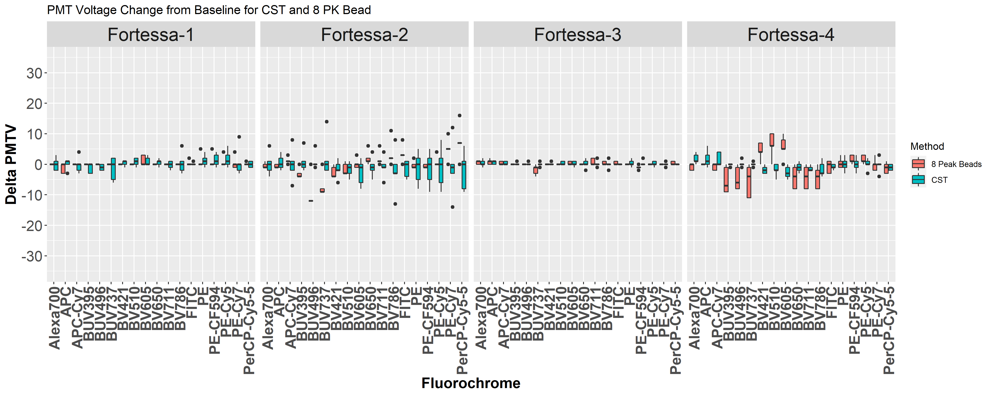
Assessing Flow Cytometer Performance and Stability Using 8-Peak Rainbow Beads
Author(s): Francesca Abulencia¹, Yi Ren¹, Felisha Lopez¹, Pu Zhang¹, Giri Buruzula¹
Affiliation: ¹Exploratory Immuno-Oncology; Novartis Institutes for Biomedical Research, Cambridge, MA
Data analysis was done using FlowJo and visualized using R
Abstract:
The Immuno-Oncology Flow Cytometry Facility performs quality control (QC) checks on cytometers to ensure the data collected daily is reliable and reproducible. Cytometer Setup & Tracking (CST) module on BD cytometer measures median fluorescence intensity (MFI) and percent robust CV (%rCV) of the bead, evaluates linearity, detector efficiency (Qr), optical background (Br), electronic noise, laser delays, and automatically adjusts photomultiplier tube (PMT) voltages to maximize the resolution. A secondary QC was conducted using 8-Peak Rainbow Beads (8 PK RB) to verify the results from CST. Changes in PMT voltages and other parameters related to 8 PK RB signals were monitored to assess the stability of 4 BD LSRFortessas. After analyzing one week’s worth of data, the results show that the variation between the 2 QC methods is within an acceptable range for PMT and rCV values, indicating that 8 PK RB is a good secondary verification method for instrument performance.
Figure 3: 8 PK RB Percent Change in MFI from Baseline
Figure 5: Stain Index Calculation for Fortessa-1
Table 1: Unified Configurations for the BD Fortessa Instruments
$$\text{Stain} \text{Index}\text{ (}\text{SI}\text{) = } \frac{\text{MFI}\text{P}\text{os}\text{ – }\text{MFI} \text{Neg}}{\text{2 }\text{x} \text{rSD} \text{Neg}}$$
Laser | Dichroic | Bandpass | Wavelength Detected | Default Fluorophore
355nm 65mW UV | 690 LP | 740/35 | 723 - 758 | BUV737
 | 450 LP | 515/30 | 500 - 530 | BUV496
 | - | 379/28 | 365 - 393 | BUV395
405nm 100mW Violet | 750 LP | 780/60 | 750 - 810 | BV786
 | 695 LP | 710/50 | 695 - 735 | BV711
 | 635 LP | 670/30 | 655 - 685 | BV650
 | 595 LP | 610/20 | 600 - 620 | BV605
 | 505 LP | 525/50 | 505 - 550 | BV510
 | - | 450/50 | 425 - 475 | BV421
488nm 100mW Blue | 685 LP | 695/40 | 685 - 715 | PerCP-Cy5-5
 | 505 LP | 530/30 | 515 - 545 | FITC
 | - | 488/10 | 483 - 493
561nm 100mW* Yellow-Green | 750 LP | 780/60 | 750 - 810 | PE-Cy7
 | 635 LP | 670/30 | 655 - 685 | PE-Cy5
 | 600 LP | 610/20 | 600 - 620 | PE-CF594
 | - | 586/15 | 579 - 594 | PE
640nm 100mW Red | 750 LP | 780/60 | 750 - 810 | APC-Cy7
 | 710 LP | 730/45 | 710 - 750 | Alexa700
 | - | 670/30 | 655 - 685 | APC
Peak 4
Peak 1
$$\text{SI}\text{ = } \frac{\text{MFI}\text{Peak} \text{1}\text{ – }\text{MFI} \text{Peak}\text{ 4}}{\text{2 }\text{x} \text{rSD} \text{Peak}\text{ 4}}$$
*
The SI determines the relative brightness of a fluorochrome compared to other fluorochromes. Fluorochromes with larger stain indexes are brighter and have better resolution. Depending on the level of antigen expression for a given marker, SI is critical in determining antibody and fluorochrome pairs during panel design to accurately identify and separate cell subpopulations. The bar graph on the right shows representative data for the SI values for each fluorochrome in descending order. Although all 4 Fortessas are identically configured, there are slight variations in this ranking due to differences in the fluidics, electronics, and optical systems.
Results:
Discussion:
Although the data shows slight variations in actual MFI and rCV values between each instrument, the day to day changes compared to a baseline value is minimal. For the violet and UV laser detectors, greater variations in MFI may be apparent as 8 PK RBs were originally manufactured for flow cytometers with blue, red, and yellow green lasers. All 4 instruments are producing stable results. Thus, 8 PK RBs may not be optimally excited by the UV and violet lasers. Additionally, stain index information is critical for panel design, and tracking the stability of the signal resolution is useful in monitoring performance issues before servicing is required.
Figure 1: Tracking Instrument Stability Using 8 PK RB
Background:
In flow cytometry, suspension of single cells stained with antibodies conjugated to fluorochromes are exposed to multiple laser beams. The fluorochromes, with their unique excitation and emission spectra, emit fluorescent light upon laser excitation. The light is detected by the PMTs where incoming photons are converted to electrons. These electrons are amplified by a series of dynodes, producing a current that is converted into a digital signal. Increasing the voltage applied to a PMT amplifies the signal as well as the background noise.¹ Thus, optimizing voltages to maximize signal to noise ratio is crucial for obtaining high quality data. A secondary QC method using 8 PK RBs can verify CST optimized PMT voltages. This ensures that data generated by IO flow cytometry facility users is reliable and consistent.
Day 1
Day 2
Day 3
Day 4
Day 5
Day 1
Day 2
Day 3
Day 4
Day 5
Day 1
Day 2
Representative data for percent change in MFI from Fortessa-1 and Fortessa-3. Using the baseline MFI value from Day 1, the percent change of MFI for fluorochromes excited by the yellow-green, blue, and red laser are within 5% for all 4 instruments. For fluorochromes excited by violet and ultraviolet lasers, the range varies from 5% to 25%.
Day 3
Day 4
Conclusions:
Changes in PMT voltage from CST and 8 PK RB are within the acceptable range to pass QC.
Similar trends in MFI and rCV are present for both QC methods for all 4 instruments, indicating that 8 PK RBs are a good secondary QC verification method.
Variations in MFI and rCV from a baseline value are minimal across 4 instruments, indicating instrument stability.
Day 5
Figure 4: Daily Measurement of Robust Coefficient of Variation
The 5-day concatenated data from Fortessa-4 shows the peak separation from 8 PK RB. Peak 4 for BUV496, highlighted in red, exhibits good separation from neighboring peaks. In contrast, peak 4 for BUV737 has poor separation from peak 5.
*
Figure 2: ∆PMTV from Baseline Value for 2 QC Methods
Materials and Methods: Bead Preparation
Mix 2 drops of BD CS&T Beads (Lot # 75707) with 500uL of H₂O in a tube.
Mix 2 drops of BioLegend 8 PK RB (Cat # 122903) with 500uL of H₂O in a tube.
Instrument Setup
Perform CS&T Performance Check
Run the 8-Peak Beads and adjust the PMT Voltage for each channel to align the MFI of the brightest peak around 10⁵.
References:
Giesecke C, et al. Cytom Part A. 2017; 91(11):1104-1114
Acknowledgments:
We want to thank Stephanie Pan and Connie Gee from IO, as well as Russette Lyons and Jessica Garver for their assistance on this internship program.
Representative data for rCV values for the brightest peak from both QC methods. For all 4 Fortessas, both QC methods exhibit minimal rCV variations across 5 days. Instruments will pass QC if rCV is within 6%. *Peak 3 was used for BUV395’s brightest peak for 8 PK RB as peaks 1 and 2 are not well separated.
In order for CST to pass, ∆PMTV must be less than 50 volts. Based on CST and 8 PK RB data, ∆PMTV is within ± 20 volts.
A Summer of Science @ Novartis
Notes:
Fig 3: alignment of peak 2-4
Outlier = air bubble or dirt? Clean with bleach
Fortessa 4, slightly more sensitive on that day, variations i
SI metric for separting pos and neg pop. Alsso resolution of given detector
I chose peak 4. Not all channels separate well after peak 4

